Slide 1

Deep Learning–Based Glacier Semantic Segmentation Using Multispectral Satellite Imagery: Binary and Multi-Class Modeling
Presented by: GANTYADA TEJESH KUMAR (Regd. No.: 2202040015)
Presented by: BINOD KUMAR BEHERA (Regd. No.: 2202081070)
Presented by: CHINMAYA KUMAR BEHERA (Regd. No.: 2202081078)
Supervisor: Dr. Bighnaraj Naik, Department of CSE, VSSUT Burla (2025–26)
DEPARTMENT OF COMPUTER SCIENCE AND ENGINEERING AND INFORMATION TECHNOLOGY
VEER SURENDRA SAI UNIVERSITY OF TECHNOLOGY, BURLA
Notes:
1

Slide 2
CONTENTS
Introduction
Motivation & Need
Problem Statement one
The Flawed Approach
Literature Review Summary
Multispectral Data
Dataset Description
The Challenge: Imbalance
PS1 Model Overview
PS1: Sample Output
Problem Statement Two
Dataset Description: Fuel
Problem Statement Two pie Chart
PS2 Model Overview
Input / Output
Interactive Dashboard
End To End System
Key Objectives
Performance Summary
Future Directions / Conclusion
Notes:
2

Slide 3
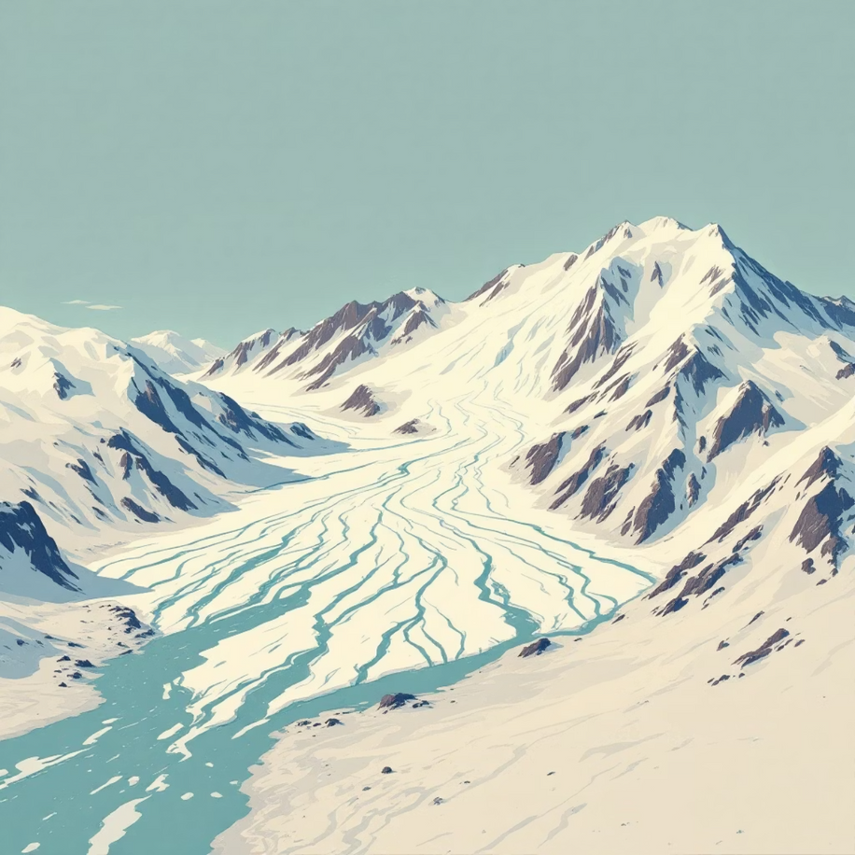
Introduction: Glaciers Mapping
About the Challenge GlacierHack 2025
Global AI competition on glacier monitoring
Uses multi-band satellite imagery
Focus on climate risk & environmental sustainability
Problem Statement
Glaciers changing rapidly due to climate warming
Manual mapping is slow and inconsistent
Need automated pixel-level glacier segmentation
Project Objective
Build two models:
Binary segmentation (Glacier / Non-glacier)
4-Class segmentation (Background, Glacier, Debris, Lake)
Achieve accurate, scalable mapping for real tiles
Notes:
3

Slide 4

Motivation & Need: Why This Research Matters
Climate Indicators
Glaciers provide the clearest visual evidence of climate change impact.
Sea Level & Water Supply
Monitoring them is crucial for predicting rising sea levels and managing vital freshwater resources for billions.
Scalability Challenge
Manual mapping by experts is slow, expensive, and cannot keep up with the pace of environmental change.
Our objective is to autonomously identify and map glacier boundaries from high-resolution satellite data.

Slide 5
Phase One :

Slide 6
Problem Statement 1 (PS1): Binary Glacier Segmentation
Our initial challenge focuses on the fundamental task of classifying each pixel within satellite imagery as either Glacier or Non-Glacier. This binary classification forms the bedrock for more intricate analysis.
Challenges in Binary Segmentation
Visual similarity between snow, ice, and surrounding rock formations, making distinction difficult.
Variations in lighting conditions and shadows that can obscure true glacier boundaries.
The inherent slowness and inconsistency of manual mapping processes.
Notes:
4

Slide 7
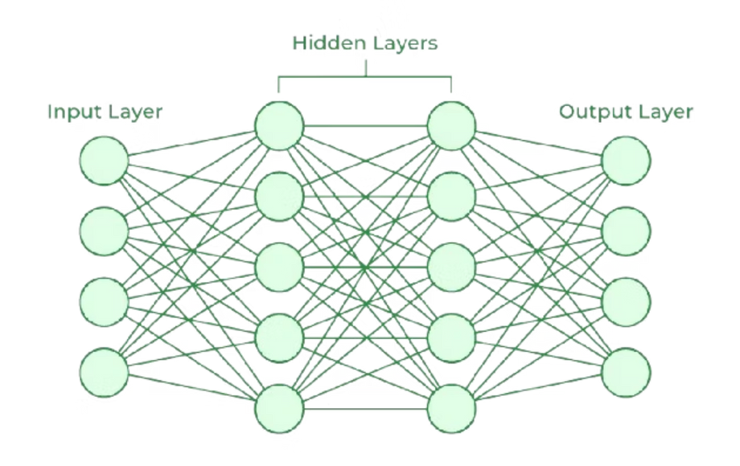
The Flawed Approach: Pixel-wise ANN
The critical flaw is the absolute lack of spatial context.
Without knowing the neighboring pixels, the model cannot distinguish between a single snowy field and the distinct texture, shape, and edges of a large, complex glacier. This is analogous to attempting image recognition by inspecting only the color value of one pixel at a time.
Single Pixel Input
Some Models Evaluation :
1. Fully Connected Network(FCN-32/FCN-16)
It has not skip connection.
2. CNN Classification
Fails to understand large image as glacier
Simple ANN
Binary Prediction (Glacier/Not)

Slide 8
Literature Review Summary: Evolving Glacier Mapping
Traditional Methods
1
Early approaches relied heavily on manual delineation, thresholding, and simple band ratios. These methods were often inaccurate, especially in complex glacier environments.
2
Machine Learning (ML)
The advent of ML algorithms, improved classification accuracy. However, they consistently struggled with the heterogeneity of debris-covered ice regions.
Deep Learning (DL)
3
4
Identified Research Gaps
Convolutional Neural Networks (CNNs), particularly architectures like U-Net and Fully Convolutional Networks (FCNs), marked a significant leap. They achieved superior pixel-level accuracy and demonstrated strong generalisation capabilities.
Persistent class imbalance challenges in datasets.
Limited development of multi-class glacier segmentation models.
Scarcity of deployable tools for real-world application.
Underutilisation of the full potential of multispectral bands.
Notes:
8

Slide 9

Understanding the Multispectral Data
1
2
3
B2 (Blue)
B3 (Green)
B4 (Red)
4
5
B6 (Short-Wave Infrared- SWIR)
B10 (Thermal Infrared- TIR1)
Multispectral Input
Ground Truth Mask
Satellite images containing 5 distinct channels (Bands 1-5). These include traditional visible (RGB) light plus infrared bands, offering chemical and thermal information invisible to the human eye.
The labeled output, a binary mask (Glacier = 1, Not Glacier = 0), derived from expert manual mapping. We use 1,475 image tiles for training.
Segmentation Goal
To achieve pixel-level classification. Every one of the 256x256 pixels must be labeled as either glacier or not-glacier.

Slide 10




Dataset Description: Fueling the Models
Multispectral Tiles
Paired Masks
The core dataset comprises 125 multispectral satellite tiles, stored in the .tif format. Each tile contains valuable spectral information across multiple bands.
Each multispectral tile is precisely paired with its corresponding ground truth mask, providing labels for either binary (Glacier/Non-Glacier) segmentation.
PS2 Mask Label Mapping
Extreme Pixel Imbalance
Class 0: Background
A significant characteristic is the pixel imbalance, notably with water bodies constituting less than 18 % of the total pixels. This necessitates careful handling during model training.
Class 1: Clean Ice
Notes:
10

Slide 11


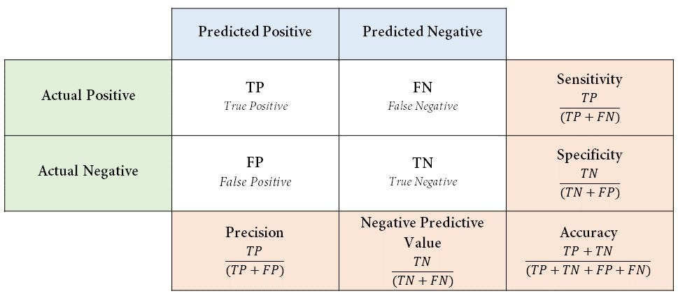
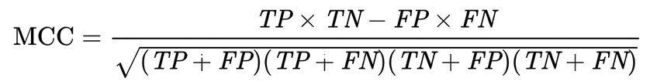
The Challenge: Imbalance
Key Challenges
Severe Class Imbalance
Visual Ambiguity
The majority of pixels are "Not Glacier." A model that always predicts '0' would have high accuracy but be useless.
Ice, snow, clouds, and debris-covered ice all share similar spectral characteristics, making differentiation difficult.
Simple Accuracy
The Robust Metric: MCC
Matthews Correlation Coefficient (MCC)
MCC is superior simple accuracy for imbalanced data. It assesses all four confusion matrix categories (TP, TN, FP, FN), yielding a value between -1 (perfect misclassification) and +1 (perfect classification).

Slide 12



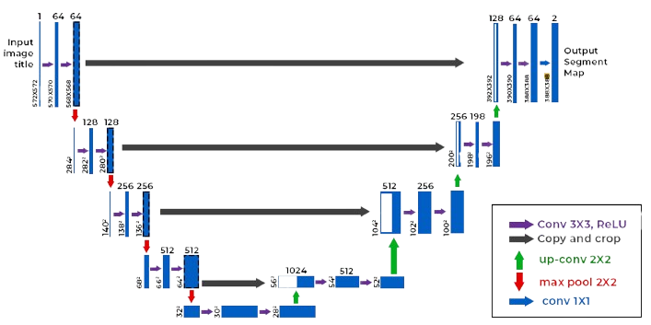
PS1 Model Overview: U-Net Architecture
Encoder Path (Context)
Decoder Path (Localization)
Skip Connections (Fidelity)
A contracting path that captures high-level features (e.g., "there is a large icy object here") through successive convolutions and pooling.
An expansive path that precisely localizes the features, reconstructing the image mask pixel-by-pixel to define the exact boundaries.
These are the core innovation: they pass high-resolution feature maps directly from the encoder to the decoder, ensuring that fine-grained details and sharp edges are preserved.
U-NET DAIGRAM

Slide 13
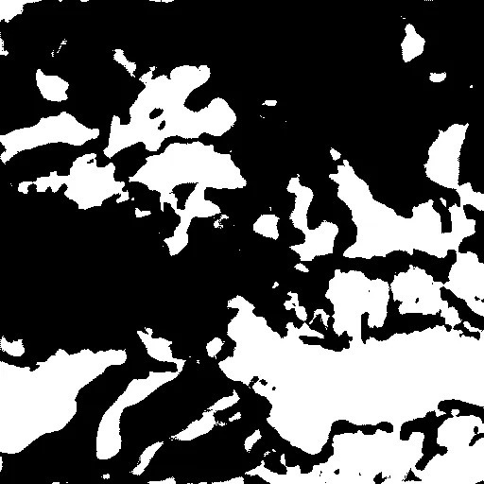
PS1: Sample Output (Binary Mask)
The PS1 model demonstrates strong performance in identifying glacier boundaries, providing a clear binary mask of glacier presence.
Input Multispectral Tile
Predicted Binary Glacier Mask
Boundary Detection
Raw satellite imagery showing a glacier region.
Clear detection of glacier extent, distinguishing from non-glacier areas.
Accurate delineation of glacier edges, particularly in clean ice regions.

Slide 14
Phase Two :

Slide 15
Problem Statement 2 (PS2): Four-Class Glacier Segmentation
Beyond Binary
Specific Challenges Encountered
Clean Ice: Pristine, exposed ice surfaces.
Overcoming strong class imbalance, particularly the scarcity of water body pixels.
Debris-covered Ice: Ice hidden layers of rock and sediment.
Distinguishing the visual similarity between debris-covered ice and adjacent rocky terrain.
Lakes: Liquid water bodies on or near glacier surfaces.
Accurately identifying and segmenting very small water-body regions, which are often critical indicators of melt.
Background: Non-glacier terrain.
Our goal for this phase is to construct a 4-class semantic segmentation model leveraging the advanced capabilities of a ResNet34-U-Net architecture.
Notes:
5

Slide 16
Dataset Description: Fueling the Models
Multispectral Tiles
Paired Masks
The core dataset comprises 125 multispectral satellite tiles, stored in the .tif format. Each tile contains valuable spectral information across multiple bands.
Each multispectral tile is precisely paired with its corresponding ground truth mask, providing labels for either binary (Glacier/Non-Glacier) or 4-class segmentation.
PS2 Mask Label Mapping
Extreme Pixel Imbalance
Class 0: Background
A significant characteristic is the extreme pixel imbalance, notably with water bodies constituting less than 0.05 % of the total pixels. This necessitates careful handling during model training.
Class 1: Clean Ice
Class 2: Debris Ice
Class 3: Water

Slide 17
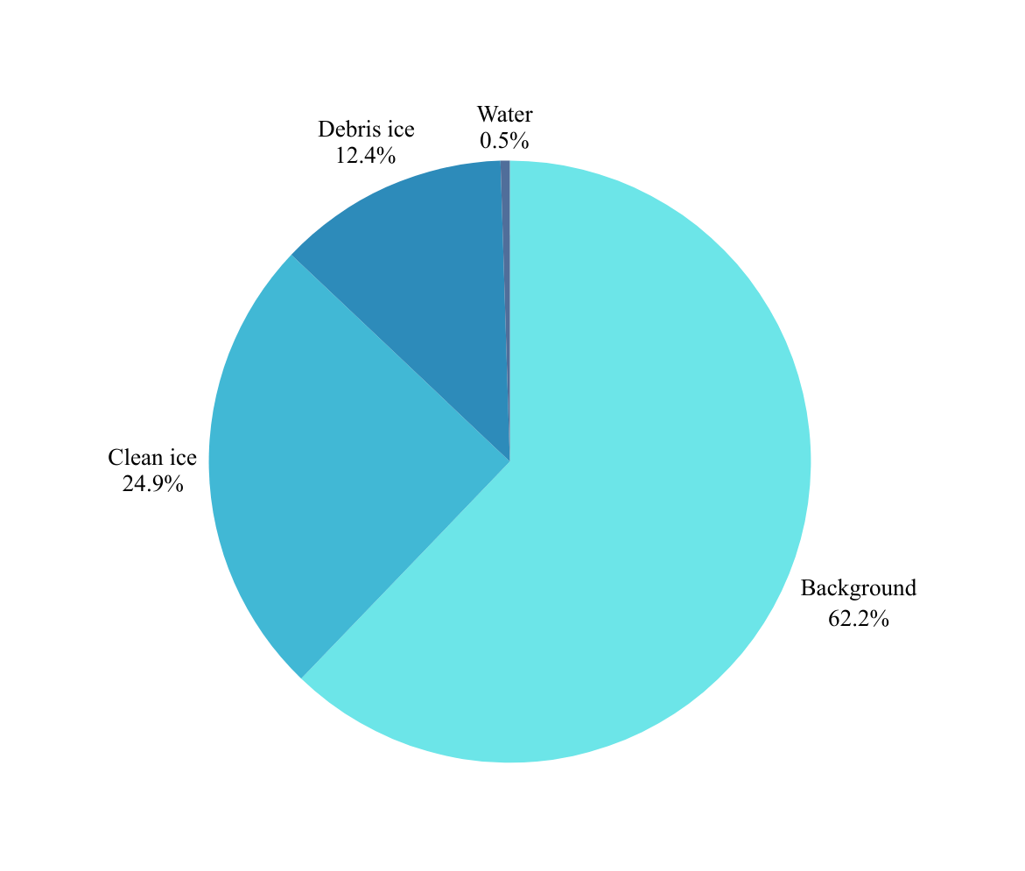
PIE CHART
Background
Clean ice
Debris ice
Water
Background
Clean Ice
Debris Ice
Water
This imbalance (4.5M+ background pixels vs. ~3k water pixels) posed challenges, which we mitigated using class weighting and Dice Loss for improved training stability and accuracy.

Slide 18
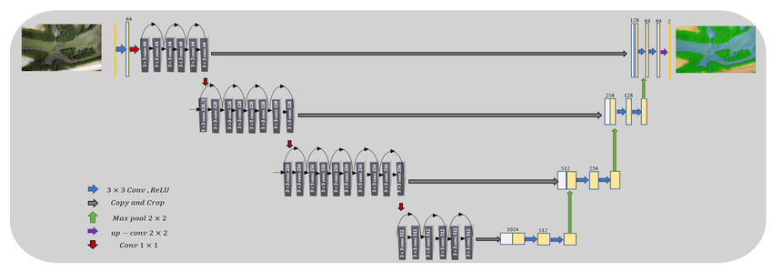
PS2 Model Overview: Four-Class Segmentation
01
03
ResNet34 U-Net Architecture
Advanced Loss Function
Leveraging a powerful ResNet34 encoder, pretrained on ImageNet, for superior feature learning.
Combines Weighted Cross-Entropy with Dice Loss to handle class imbalance effectively.
02
5-Band Input, 4-Class Output
Processes multispectral data to classify pixels into Background, Clean Ice, Debris Ice, and Water.
ResNet34 X U-Net Daigram
The integration of ResNet34 with the U-Net architecture enhances the model's ability to discern subtle differences between glacier classes.
Key techniques include patch sampling, weighted loss, LR scheduling, and mixed precision training for robust performance.

Slide 19

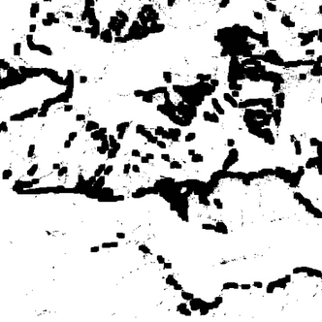

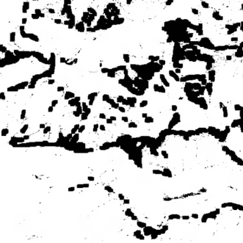

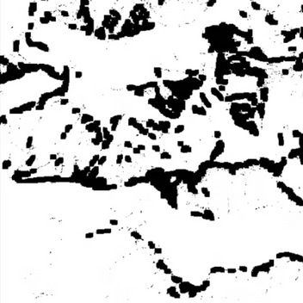
INPUT IMAGES
Band 1
Band 2
Band 3
Band 4
Band 5

Slide 20
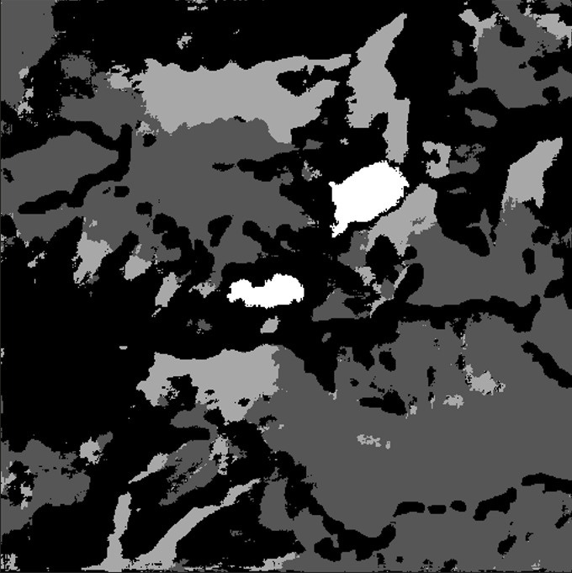
OUTPUTS / MASK
Model 1
Model 2

Slide 21
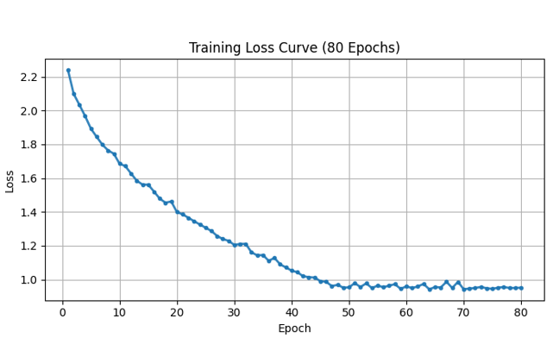
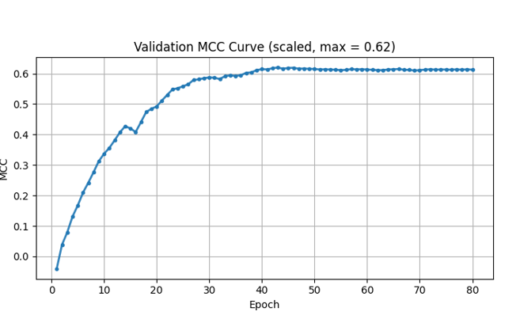
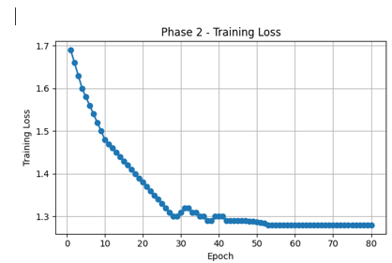
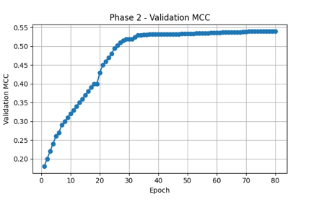
RESULTS
1: BEST MCC 0.62
Training Loss and MCC Trend for the Binary Segmentation Model
2: BEST MCC: 0.54
Training Loss & MCC Trend for Multi Class Segmentation Model

Slide 22
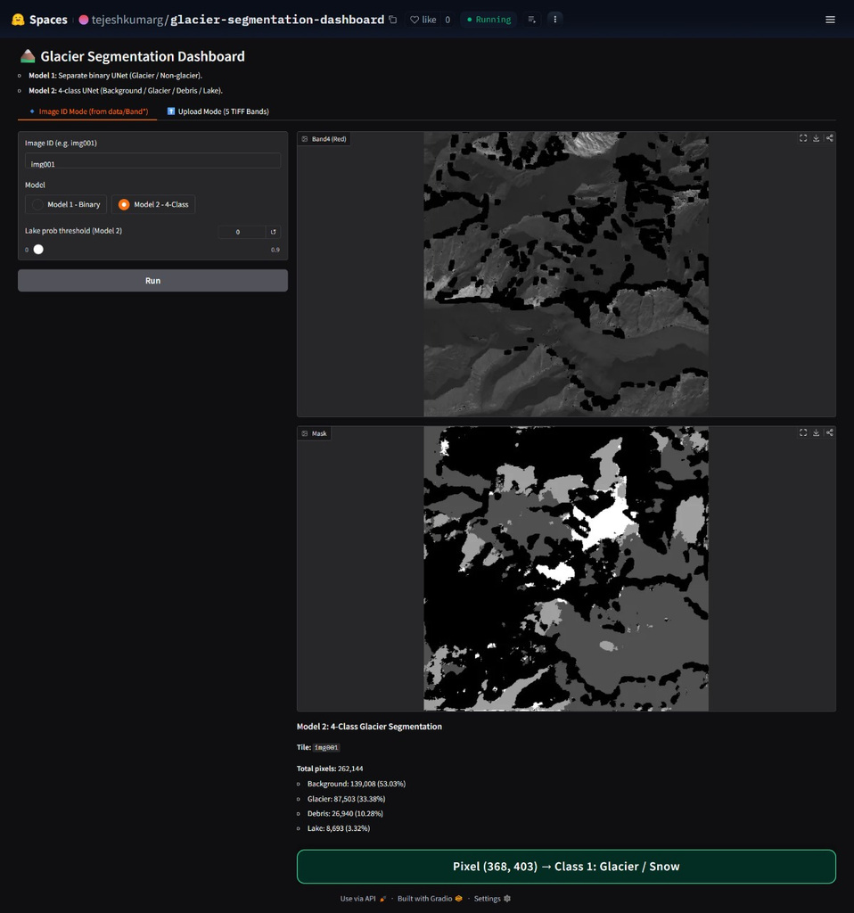
Interactive Dashboard: Real-time Glacier Analysis
Clickhere
https://huggingface.co/spaces/tejeshkumarg/glacier-segmentation-dashboard
User-Friendly Interface
Built for easy, real-time testing of both PS1 and PS2 models.
Modes
Both binary classification and multi classification model are integrated
Key Features
Includes TIFF upload, RGB composite display, segmentation mask visualisation, and overlay maps.
Broadened Accessibility
Makes advanced deep learning glacier monitoring accessible beyond research labs for broader adoption.

Slide 23
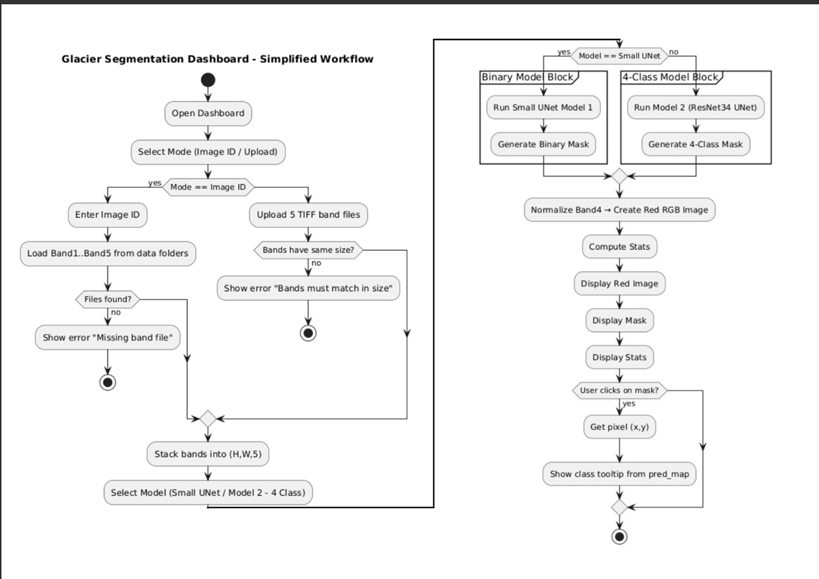
FLOW CHART OF PROCESS

Slide 24






End-to-End System Workflow
Upload TIFF Image : Multispectral TIFF images are uploaded for processing.
Preprocessing & Bands : Image preprocessing and spectral band extraction.
Model Selection :Choice between PS1 (binary) or PS2 (4-class) models.
Deep Learning Inference : Execution of the selected deep learning model.
Generate Mask : Creation of binary or 4-class segmentation masks.
Visualisation : Output presented as Original RGB, Mask, and Overlay Map for comprehensive viewing.

Slide 25
Key Objectives for Glacier Segmentation
Automated Segmentation
1
To automatically segment glacier features from multispectral satellite data, replacing manual, labour-intensive processes.
2
Model Development
To develop a U-Net model for PS1 (binary segmentation) and a sophisticated ResNet34 U-Net model for PS2 (4-class segmentation).
3
Imbalance Handling
To effectively manage class imbalance within the dataset through strategic techniques like weighted loss functions, targeted patch sampling, and Dice loss.
4
Robust Evaluation
To rigorously evaluate model performance using comprehensive metrics, including Matthews Correlation Coefficient (MCC), Accuracy, Intersection over Union (IoU), and F1-score.
5
Interactive Dashboard
To construct an interactive dashboard, facilitating real-time prediction and visualisation of glacier segmentation for broader accessibility and utility.
Notes:
7

Slide 26
Performance Summary: PS1 vs. PS2
Feature
PS1 (Binary Segmentation)
PS2 (Four-Class Segmentation)
Model
U-Net
ResNet34 U-Net
Classes
2 (Glacier/Non-Glacier)
4 (Background, Clean Ice, Debris Ice, Water)
Complexity
Lower
Higher
Loss Function
Binary Cross-Entropy
Weighted Cross-Entropy + Dice Loss
Performance
High, stable MCC for glacier detection
Strong for clean ice/background, moderate for debris, improved for water with specific techniques
Output Use
Basic glacier extent mapping
Detailed scientific glacier analysis, structure characterisation

Slide 27
Future Directions:
Expand training with larger, more diverse datasets for enhanced robustness.
Improve water body detection algorithms for greater accuracy.
Integrate temporal analysis to monitor multi-year glacier changes.
Deploy on cloud platforms for real-time, large-scale monitoring.
Develop post-processing techniques for even cleaner segmentation boundaries.

Slide 28
Conclusion:
Successfully identifies glacier vs non-glacier regions using a U-Net model, giving accurate and clean glacier boundaries.
ResNet34-U-Net effectively segments clean ice, debris-covered ice, water bodies, and background, providing detailed glacier surface information.
A user-friendly interface allows real-time image upload, model selection, and visualization of segmentation outputs.
Multispectral satellite data enhances the model’s ability to distinguish similar-looking glacier features.
Deep learning–based segmentation offers a scalable and automated approach for future glacier monitoring and climate research.

Slide 29
! THANK YOU !

